Slide 1


K.RAMAKRISHNAN COLLEGE OF TECHNOLOGY
(AUTONOMOUS), TRICHY.
DEPARTMENT OF
COMPUTER SCIENCE AND ENGINEERING
20CS5501 DESIGN PROJECT-1
Batch No. : 14
Date : 06.12.2024

Slide 2
MEDISENSE:AI-ENHANCED HEALTH DIAGNOSTICS AND NATURAL REMEDIES
Guided by Team
DR.C.Shyamala,M.E,Ph.D MAYURI DEVI S(811722104088)
Associate Professor MONIKA M (811722104092)
MUBINA BEGUM M(811722104094)

Slide 3
OBJECTIVE OF THE PROJECT
Analyzes medical reports (e.g., urine and blood tests) from images
Provides a summary of the condition in the user's chosen language (e.g.,Tamil, English, Hindi)
Offers natural remedies for the identified health issue
Improve healthcare accessibility and understanding for people with limited medical knowledge
Provide a user-friendly platform for health diagnostics and natural remedy suggestions
Support preventive care and early intervention through timely diagnosis and recommendations

Slide 4
ABSTRACT
Medisense is an AI-powered platform that helps users understand their medical reports and offers natural remedies in their preferred language. The process starts with users uploading a photo of their medical report and choosing language.

Slide 5
LITERATURE SURVEY
TITLE OF THE PAPER | AUTHOR (S) | PUBLISHER | PAPER GIST | TECHNOLOGY USED
Automated Medical Report Analysis | S. S. Iyer, S. K. Singh, and R. K. Bedi | IEEE Journal of Biomedical and Health Informatics (JBHI), 2020 | 10.1109/JBHI.2020.2994539 | Deep Learning- Convolutional Neural Networks (CNNs)- Recurrent Neural Networks (RNNs)- Natural Language Processing (NLP)
Medical Report Analysis and Diagnosis using Machine Learning and Natural Language Processing | A. K. Singh, R. K. Verma, and S. K. Singh | IEEE International Conference on Healthcare Informatics (ICHI), 2019 | 10.1109/ICHI.2019.8904695 | Natural Language Processing (NLP) Machine Learning (ML)

Slide 6
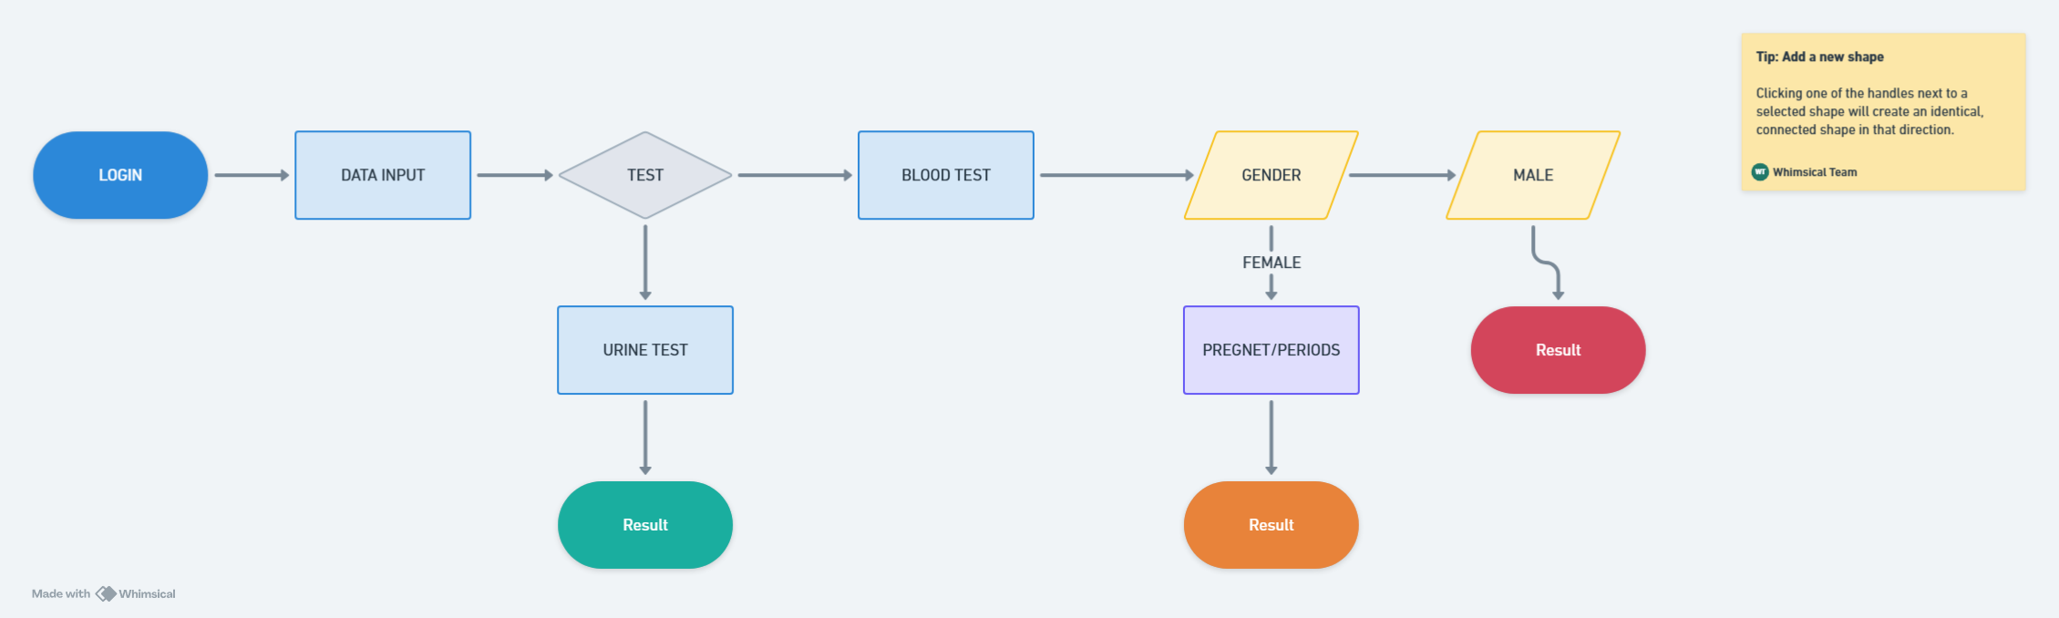
PROPOSED SYSTEM ARCHITECTURE

Slide 7
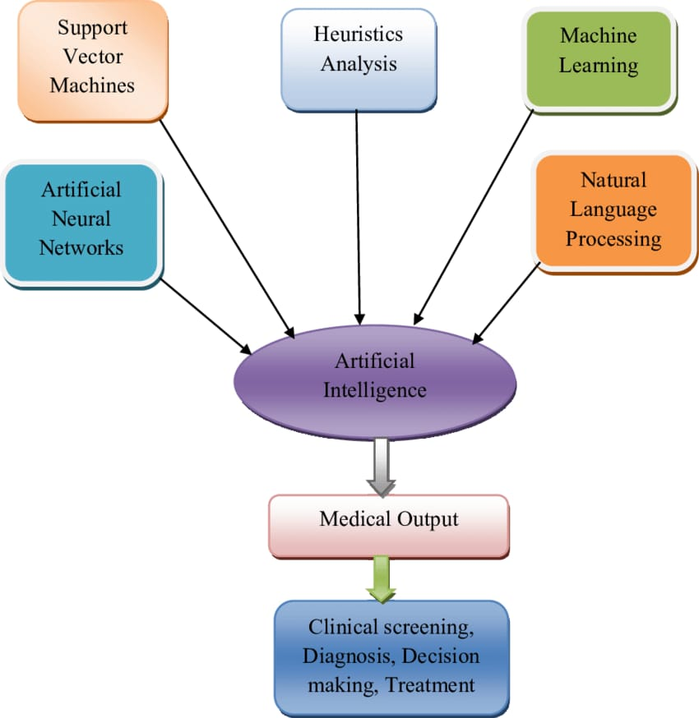
EXISTING SYSTEM ARCHITECTURE
Data Acquisition Module:Collects medical reports from various sources (e.g., hospitals, clinics) and Stores reports in a database or file system.
Analysis and Diagnosis Module:Machine Learning (ML) algorithms for disease diagnosis and prediction.
3. Summarization Module:Natural Language Generation (NLG) techniques for summarizing medical reports.
4. Remedy Suggestion Module: Knowledge Graph-based approach for suggesting natural remedies

Slide 8
SOFTWARE AND HARDWARE REQUIREMENTS
HARDWARE
SOFTWARE
Server:- CPU: Intel Xeon or AMD equivalent
Client Devices:Desktop/Laptop: Intel Core i3
Camera/Scanner: high-quality camera or scanner is required
Operating System: Server: Linux (Ubuntu, CentOS) or Windows Server - Client Devices: Windows, macOS, or Linux
Programming Languages: Python (primary language)
Frameworks and Libraries: Machine Learning: TensorFlow, PyTorc

Slide 9
MODULES
Image Processing Module
Text Analysis Module
Diagnostic Module
Natural Remedies Module
Language Localization Module

Slide 10
SUMMARY OF MODULE-1
User uploads a medical report image: Image formats: JPEG, PNG, TIFF, etc.
Image size: varies, but typically a few hundred KB
User selects their preferred language: Language options: Tamil, English, Hindi, etc.
Language selection stored in user profile or session

Slide 11
SUMMARY OF MODULE-2
OCR technology extracts text:
Tesseract OCR engine: open-source, widely used
Preprocessing techniques:
Binarization: converts image to black and white
Thresholding: adjusts image contrast
Denoising: removes noise and artifacts- Extracted text stored in temporary database or variable:
Text format: plain text, JSON, XML, etc.

Slide 12
SUMMARY OF MODULE-3
NLP pipeline:
Tokenization: breaks text into individual words or tokens Example: "blood sugar level" → ["blood", "sugar", "level"]
Stopword removal: removes common words
Example: removes "the", "and", etc.
Stemming or Lemmatization: reduces words to base form Example: "running" → "run"
Named Entity Recognition (NER): identifies medical terms Example: "blood sugar" identified as a medical term
Part-of-speech tagging: identifies word types
Example: "blood" (noun), "sugar" (noun), "level" (noun)

Slide 13
SUMMARY OF MODULE-4
Machine Learning pipeline:
Data preprocessing: Cleans and normalizes data - Handles missing values
Feature extraction: Selects relevant features from data Example: extracts "blood sugar level" value
Model training: Trains classification model on labeled medical datasets
Example: trains model to predict "diabetes" or "normal" Model evaluation: Evaluates model performance on test data Example: calculates accuracy, precision, recall
Prediction: Uses trained model to predict diagnoses for new data

Slide 14
SUMMARY OF MODULE-5
Knowledge graph database stores information about natural remedies
Graph database like GraphDB or Neo4j stores data as nodes and edges
Nodes represent remedies, ingredients, and health conditions - Edges represent relationships between nodes (e.g., "remedy treats condition")
SPARQL queries retrieve relevant remedies for the user's condition

Slide 15
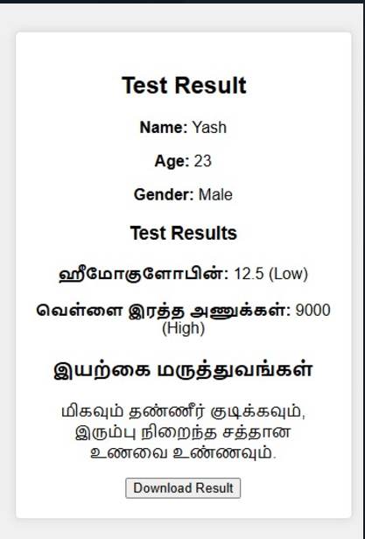
RESULTS AND DISCUSSION

Slide 16
CONCLUSION
Improve healthcare accessibility and affordability
Enhance patient engagement and empowerment
Support preventive care and early intervention

Slide 17
THANK YOU

